Slide 1


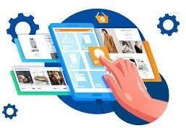
HOME Doctor
Supervised By : Ahmed Aelcherif
Project Team:
Zahra Alnasser | 220018795
Rahaf Zaki | 220020188
Batool Ali | 220008797

Slide 2
Agenda
1-Introduction
2-Problem Statement
3-Solution
4-Project Scope
5-System Analysis
6-Context Diagram
7-Functional Decomposition Diagram
8-Solution design (ERD)
9-Screen design
10-conclusion

Slide 3
1-Introduction
The home doctor system is a health care delivery model that aims to provide medical services directly in patients' homes. This system relies on providing medical care and health services in the home environment rather than requiring visits to hospitals or clinics. This approach allows patients with chronic diseases or those who have difficulty accessing medical facilities to receive the necessary care more effectively.
The home health care system includes examining patients, diagnosing their health conditions, and providing them with the necessary treatment and care. This model enables patients to interact with the medical team in their natural environment, which contributes to improving the treatment experience and reducing the need to travel between homes and medical facilities.
The home health care system is effective in providing care to patients with special needs and the elderly. It also helps relieve pressure on hospitals and clinics, and improve access to medical services.

Slide 4
2-Problem Statement
One of the major problems in healthcare is the lack of a comprehensive healthcare system. Many people have difficulty accessing medical services at home, which causes many inconveniences and challenges. The problem can be summarized with the following points
1-Lack of comfort 2-Delay in care
3-transportation fees 4-Exposure to infection

Slide 5
3-Solution
The home doctor system can fully contribute to providing better health care in their own environment. Later, a home medical regimen can be helpful
1-Comfort and access 2-Timely medical care
3-Reducing hospital admission rates 4-Prevention and education

Slide 6
4-Project Scope
The goal of the Home Doctor System is to improve and facilitate the provision of health care to patients in their own environment. Of which
Promoting access to health services, improving care for chronic conditions, providing timely medical care, reducing economic costs, enhancing communication between doctors and patients, focusing on prevention and education

Slide 7
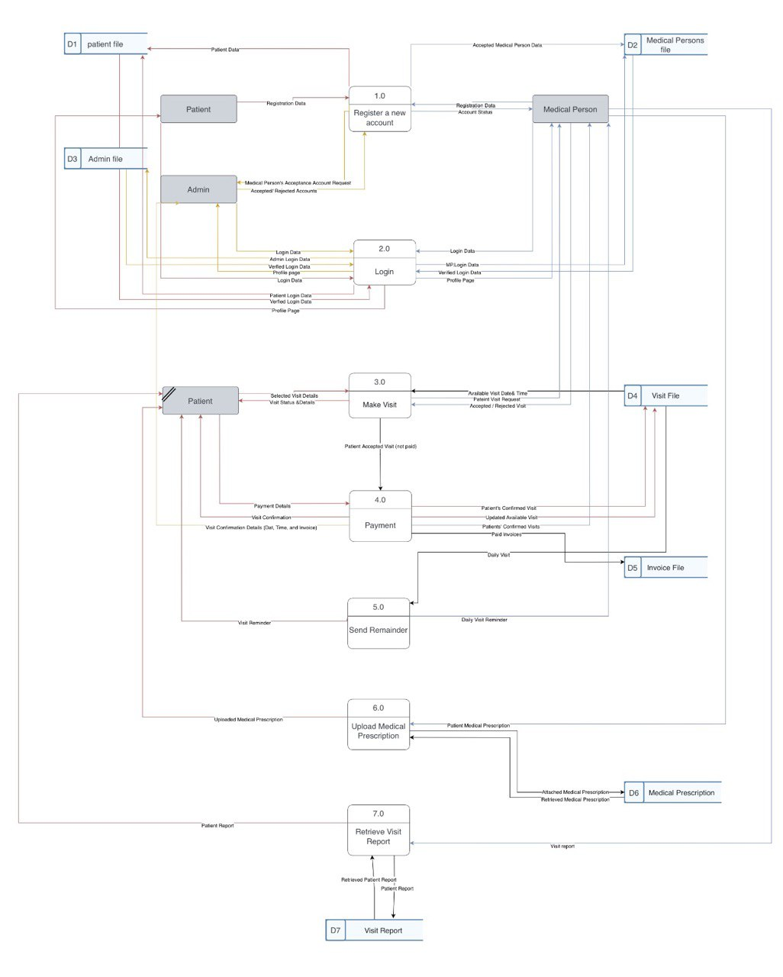
5-System Analysis

Slide 8
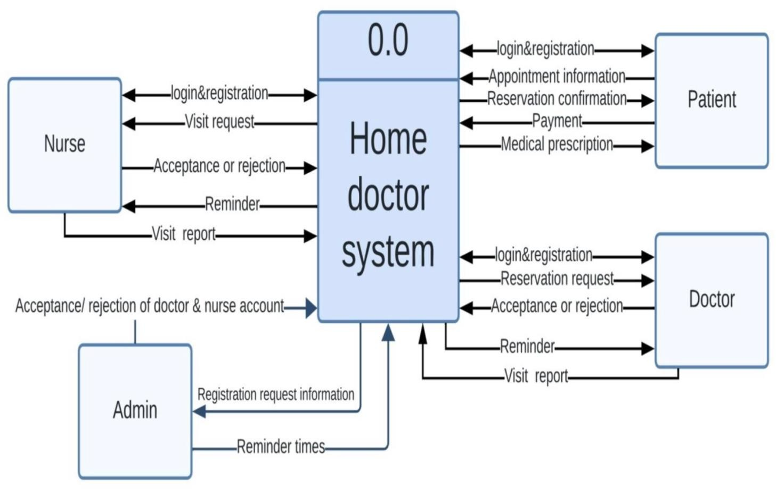
6-Context Diagram

Slide 9
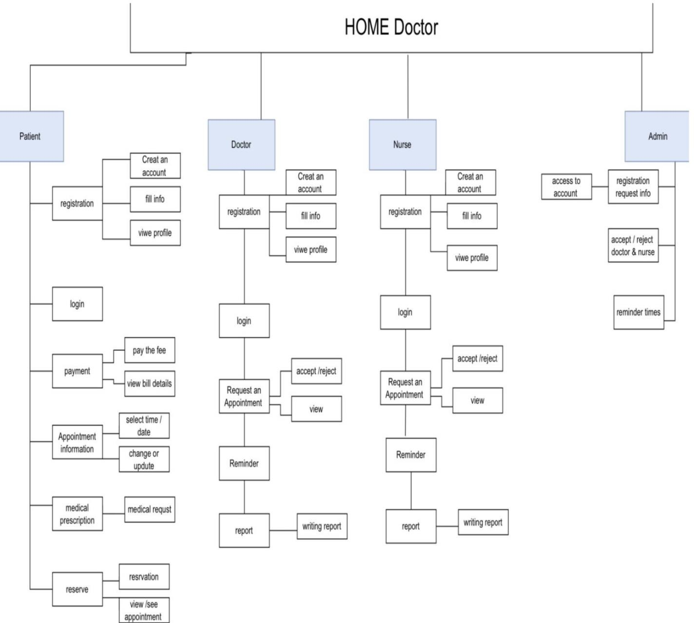
7-Functional Decomposition Diagram

Slide 10
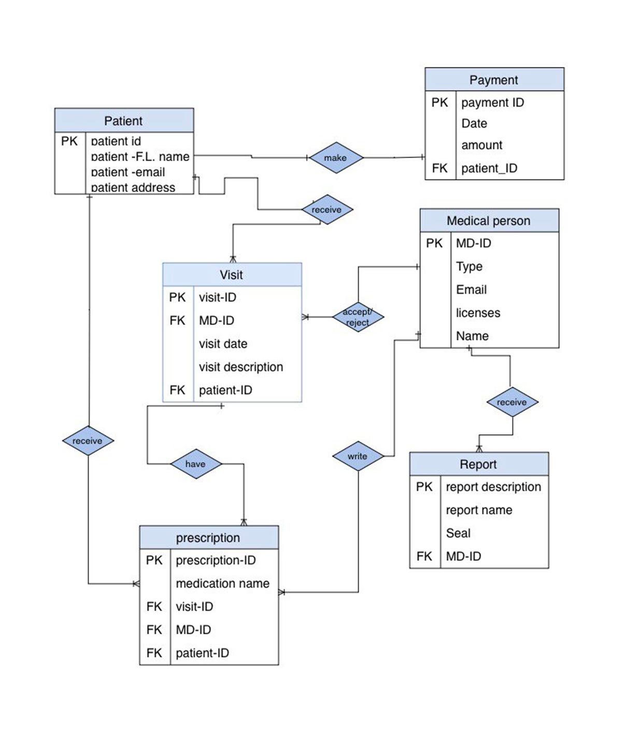
8-Solution design (ERD)

Slide 11
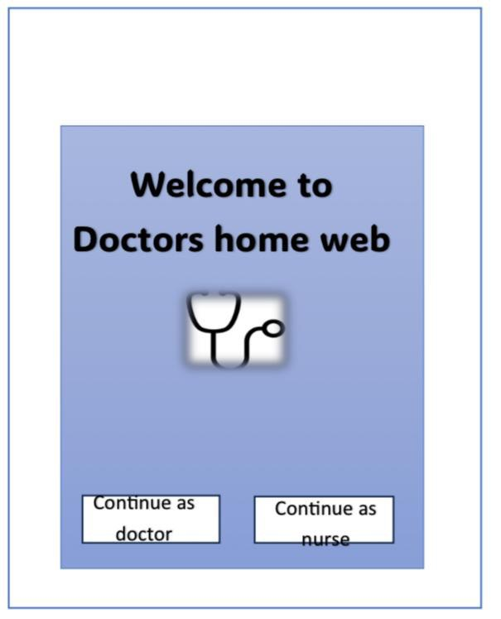
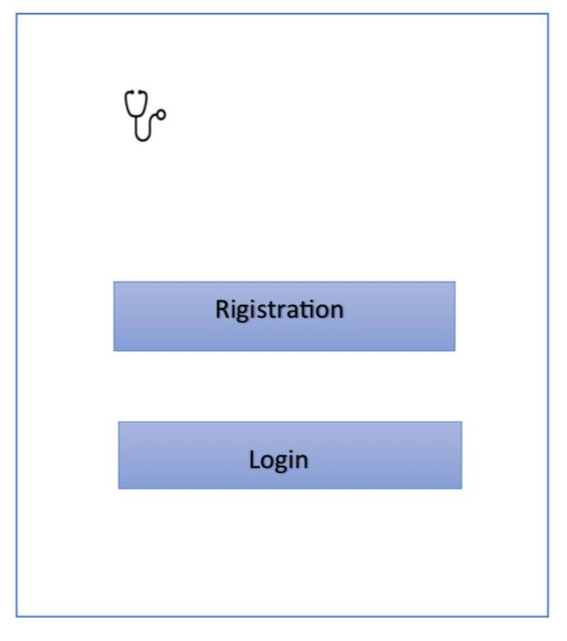
9-Screen design

Slide 12
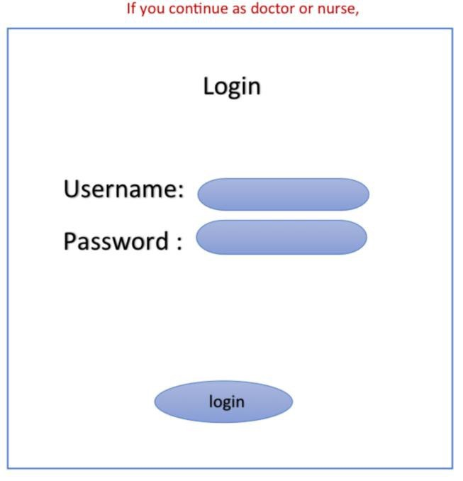
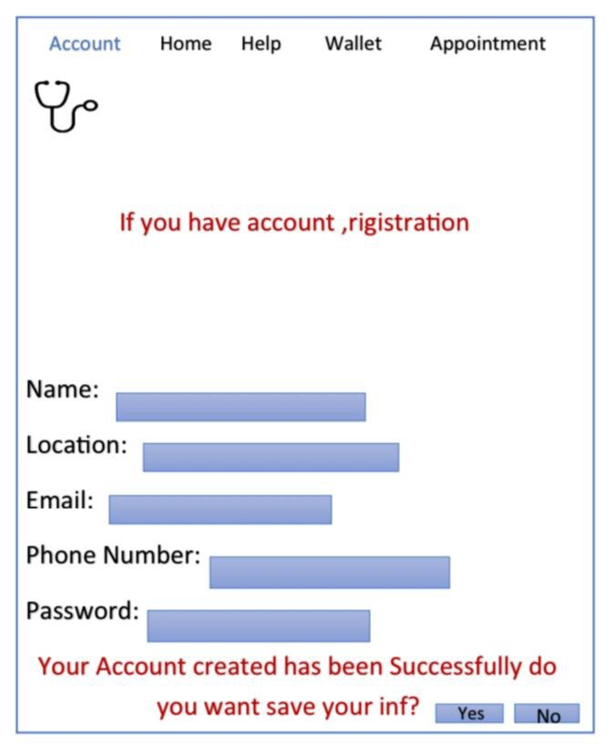
9-Screen design

Slide 13
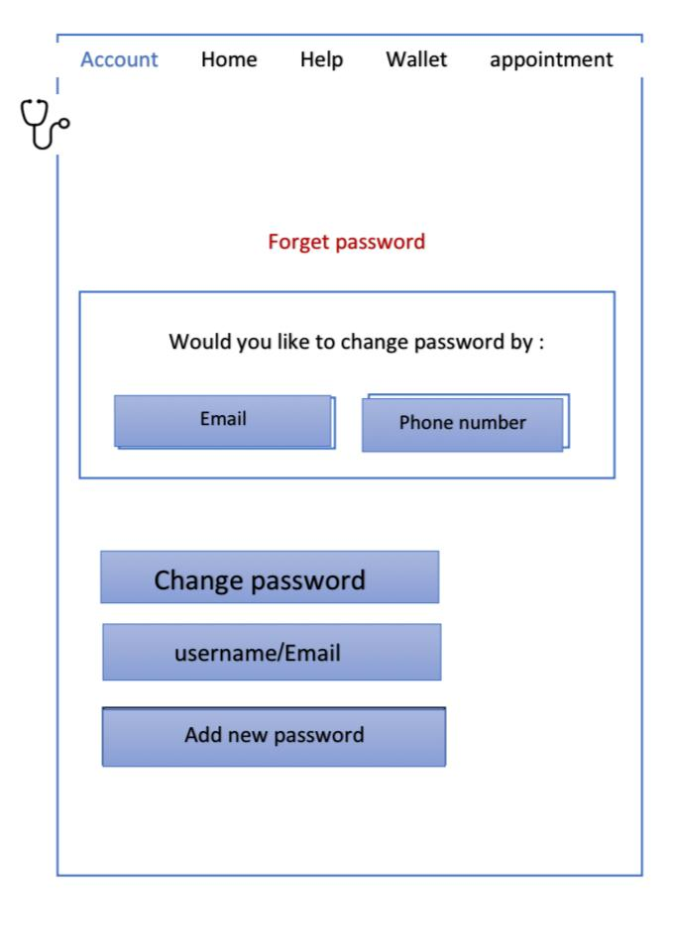
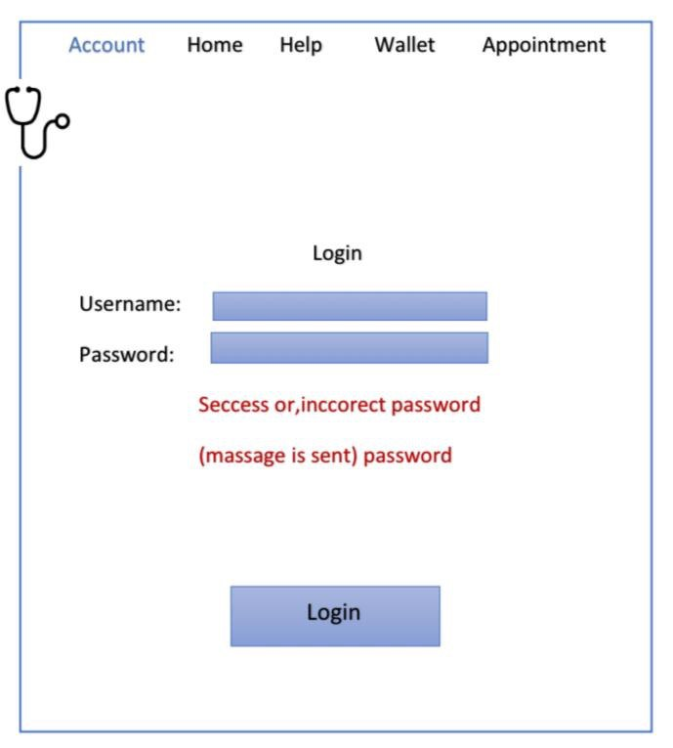
9-Screen design

Slide 14
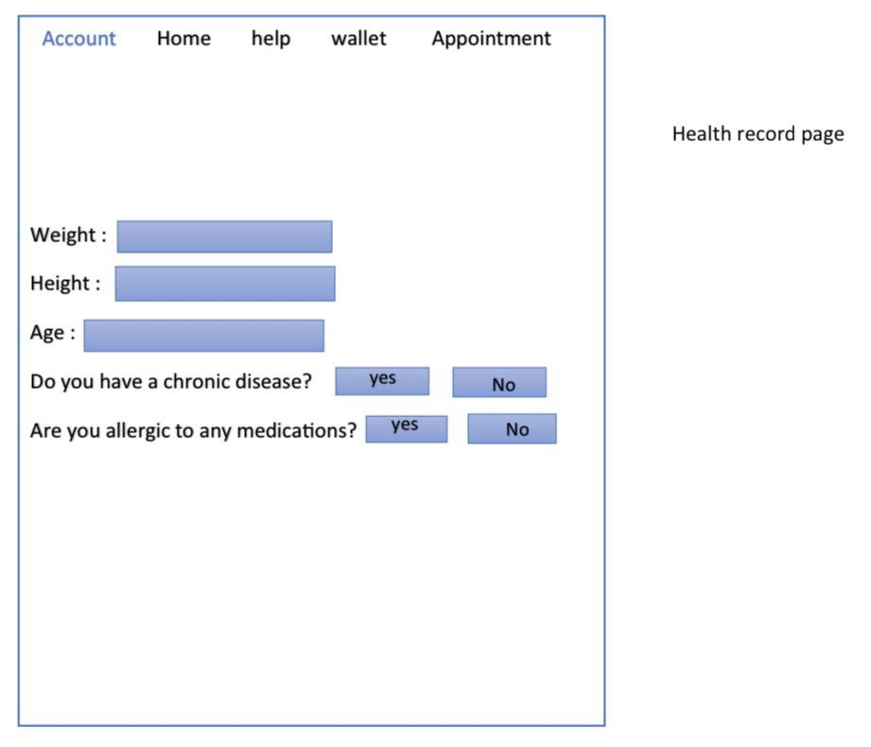
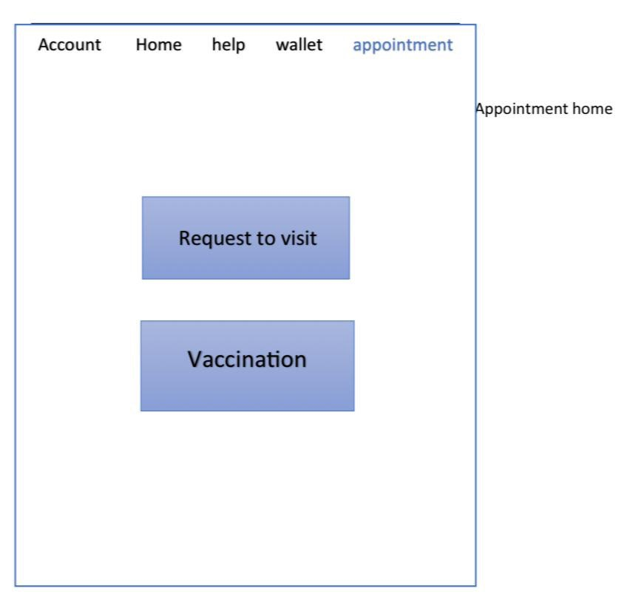
9-Screen design

Slide 15
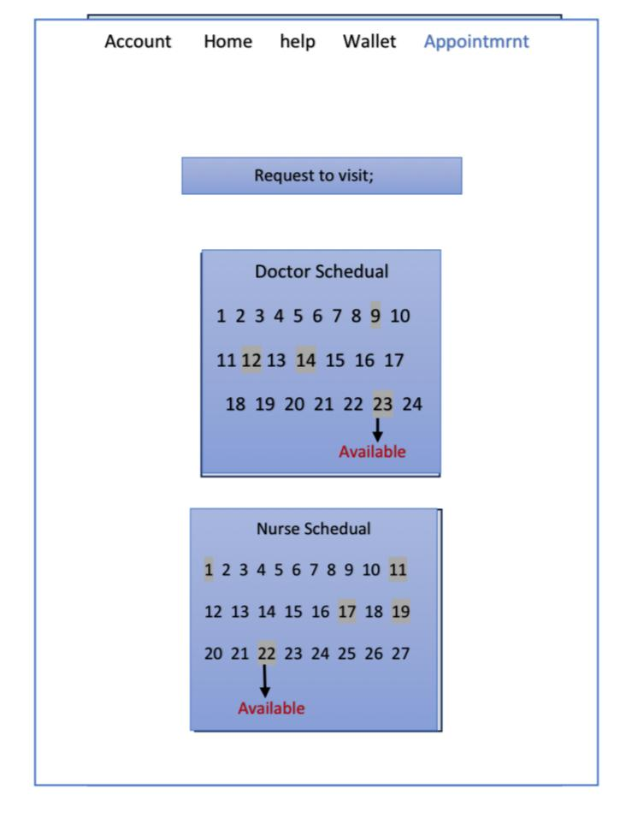
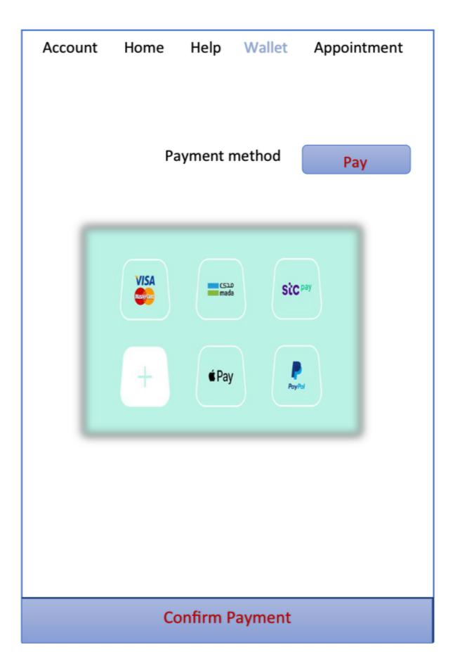
9-Screen design

Slide 16
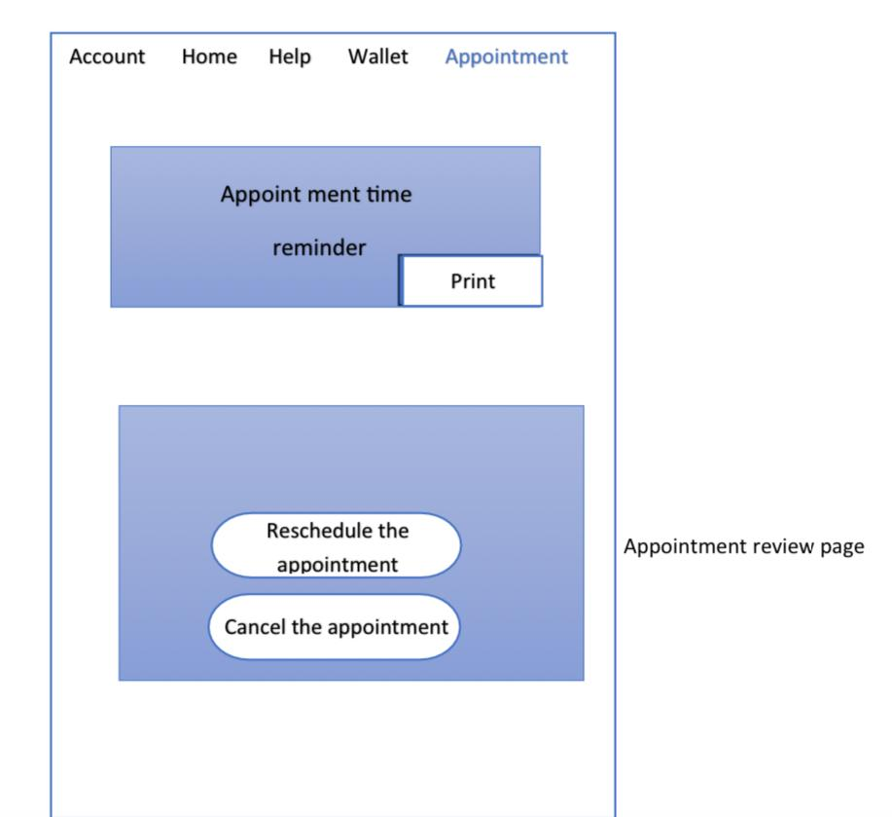
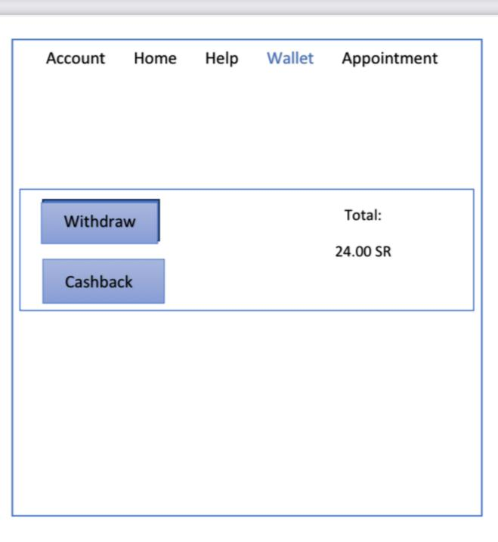
9-Screen design

Slide 17
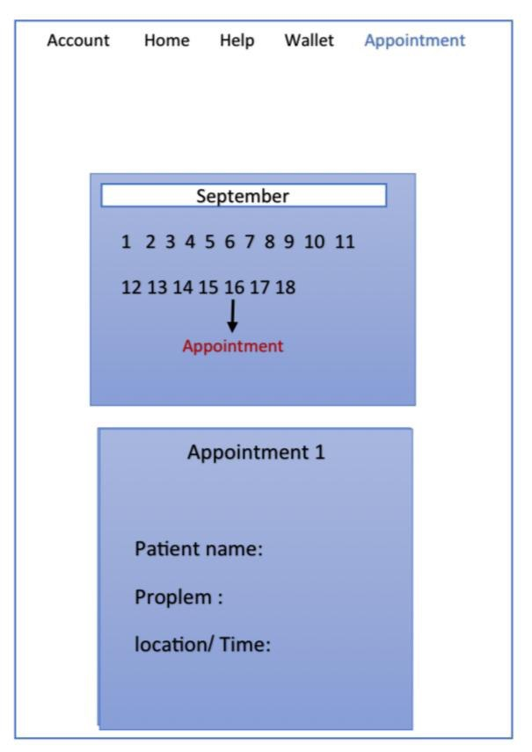
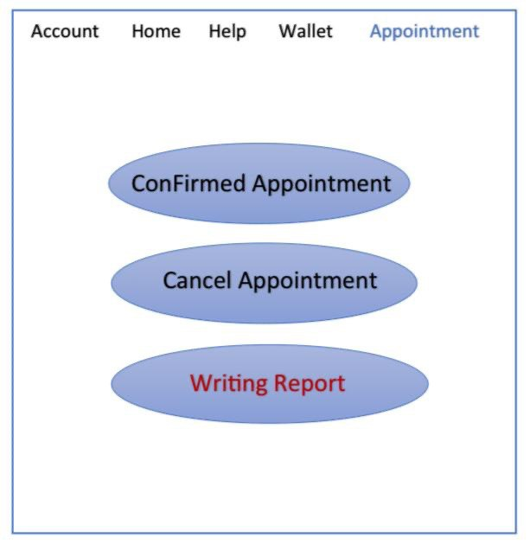

Slide 18
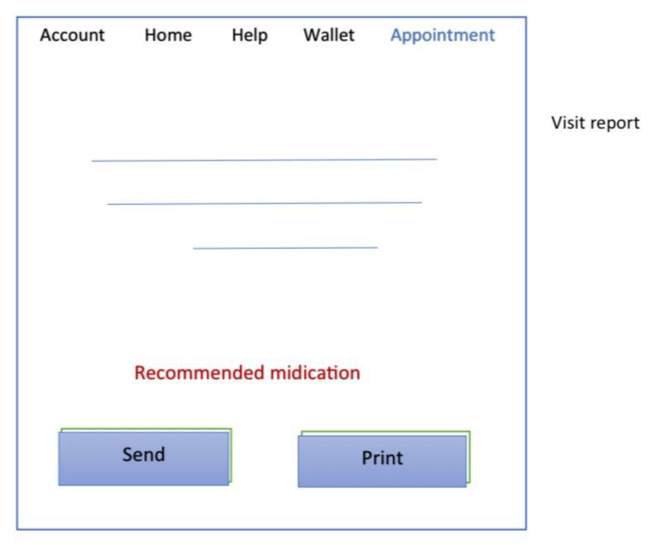
9-Screen design

Slide 19
10-conclusion
In conclusion, the home doctor system represents a groundbreaking development in healthcare delivery, putting medical care within easy reach and in the patient's environment. This system aims to comprehensively meet the community's health needs, enhancing access to medical services and improving patient experience.

